Slide 1


Brane world in f(T) gravity
Yu-Xiao Liu (Lanzhou U.)
5th International Workshop on Dark Matter, Dark Energy and Matter-Antimatter Asymmetry 暗物質、暗能量及物質-反物質不對稱
Fo-Guang-Shan, Kaohsiung, Taiwan
2018/12/30

Slide 2
Contents
1. Introduction
2. f(T) brane solutions
3. Stability and localization
4. Summary
J. Wang, W.-D. Guo, Z.-C. Lin, and Y.-X. Liu, PRD 98 (2018) 084046.
K. Yang, W.-D. Guo, Z.-C. Lin, and Y.-X. Liu, PLB 782 (2018) 170.
W.-D. Guo, Y. Zhong, K. Yang, T.-T. Sui, and Y.-X. Liu, arXiv:1805.05650.
W.-D. Guo, Q.-M. Fu, Y.-P. Zhang, and Y.-X. Liu, PRD 93 (2016) 044002.

Slide 3

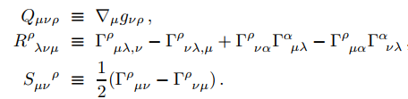
1. Introduction
Curvature ?
(R)
Torsoin ?
(T)
non-metricity Q
Curvature R
Torsion S

Slide 4
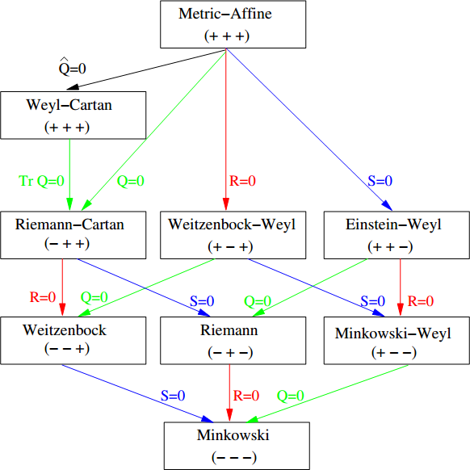
Classification of spaces (Q,R,S) and the reduction flow
tracefree nonmetricity
non-metricity Q
Curvature R
Torsion S
Y. Mao, M. Tegmark, A.H. Guth, and S. Cabi, Constraining Torsion with Gravity Probe B,
Phys. Rev. D 76, 104029 (2007) [gr-qc/0608121]
Notes:
（+，+，+）代表（Q,R,S）取值都不为零，- 号则对应相应的值为零。
Classiﬁcation of spaces (Q,R,S) and the reduction ﬂow.
Metric-Aﬃne spacetime is a manifold endowed with Lorentzian metric and linear aﬃne connection without any restrictions. All spaces below it except the Weyl-Cartan space are special cases obtained from it by imposing three types of constraints: vanish-ing non-metricity tensor Qµνρ (Q for short), vanishing Riemann curvature tensor Rµνρσ (R for short), or vanishing torsion tensor.
Weyl-Cartan space is a Metric-Aﬃne space with vanishing “tracefree nonmetricity”.

Slide 5


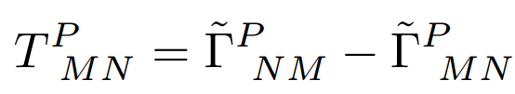
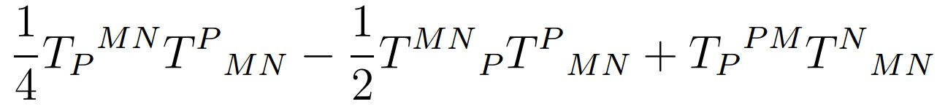

1. Introduction
Weitzenbock geometry (Q=R=0)
Vielbein
Weitzenbock connection
Torsion tensor
Torsion scalar
Notes:
combination

Slide 6
1. Introduction
Teleparallel gravity (TG)
TG was an attempt by Einstein to base a unified theory of electromagnetism and gravity on the mathematical structure of distant parallelism.
In this theory, a spacetime is characterized by a curvature-free linear connection defined in terms of a dynamical vielbein field.

Slide 7
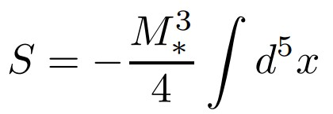

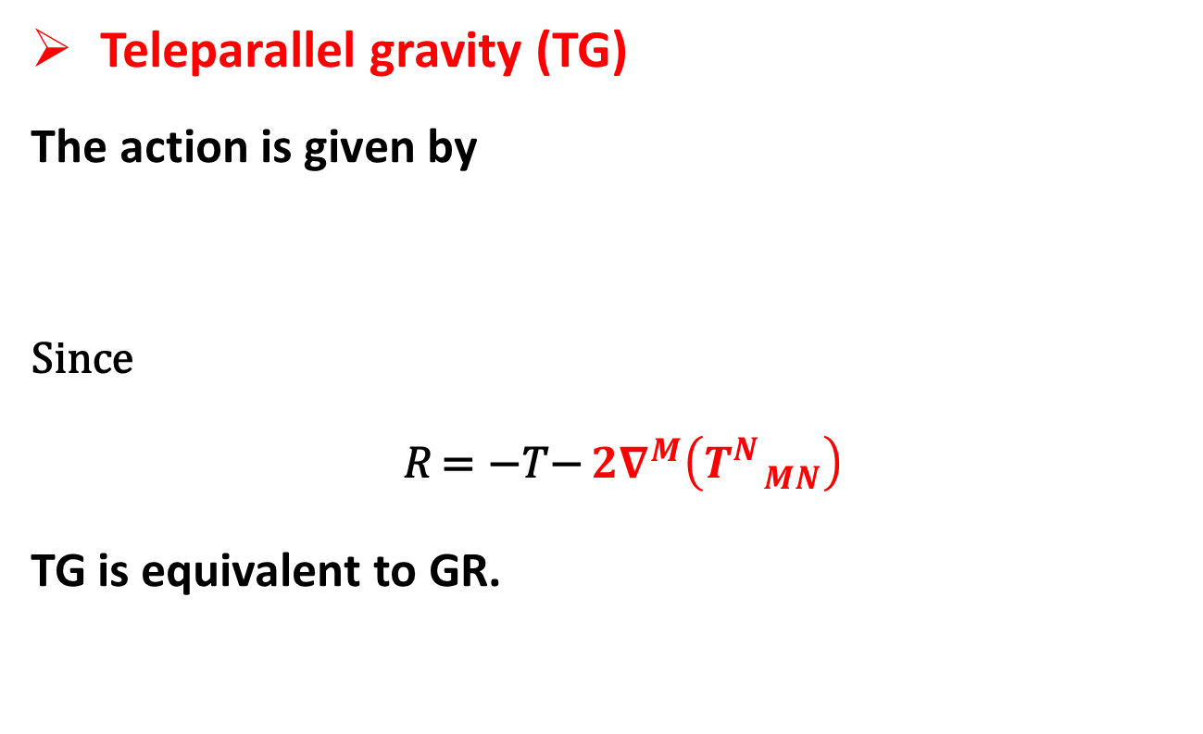
1. Introduction
Teleparallel gravity (TG)
The action is given by
Since
𝑅 = −𝑇− $2∇^{M}\left(T_{ MN}^{N}\right)$
TG is equivalent to GR.
Boundary term

Slide 8
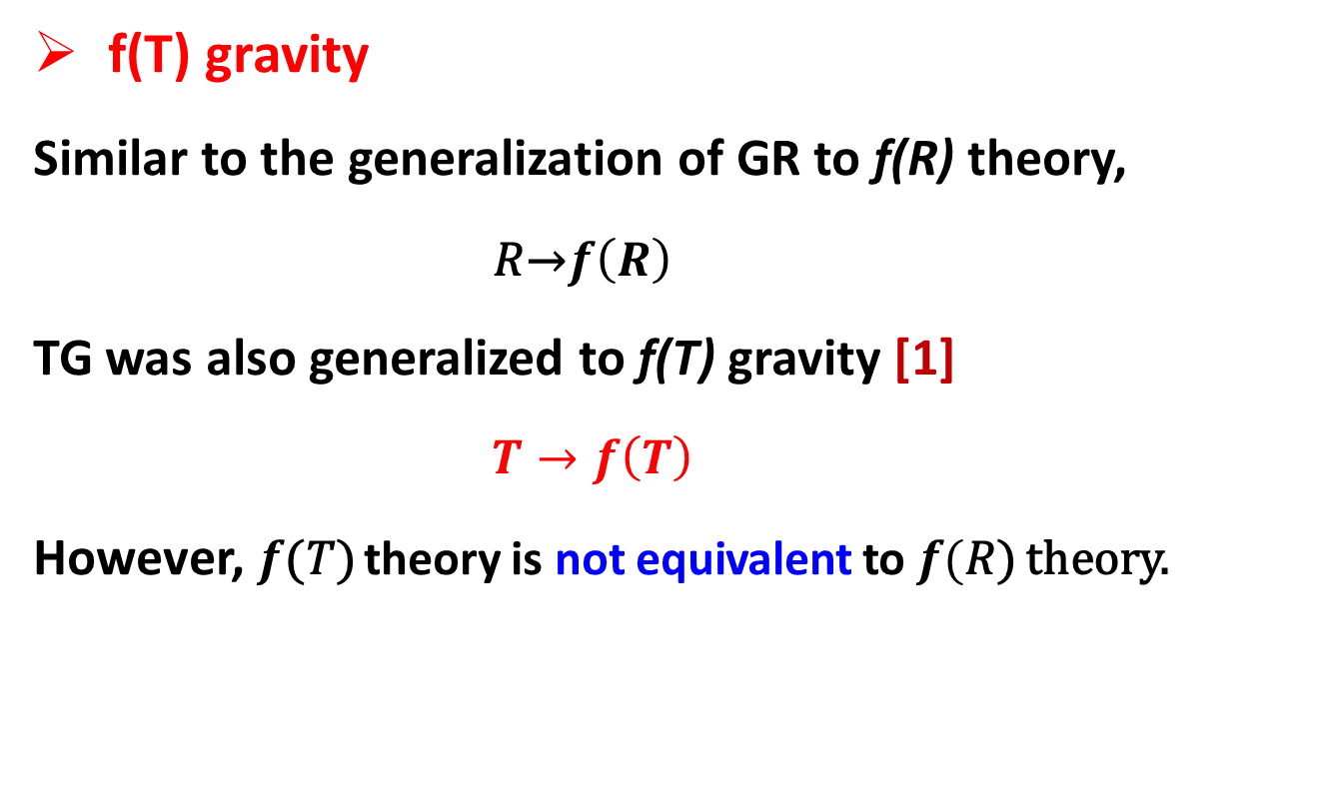
1. Introduction
f(T) gravity
Similar to the generalization of GR to f(R) theory,
𝑅→$f\left(R\right)$
TG was also generalized to f(T) gravity [1]
$T→f\left(T\right)$
However, $f$(𝑇) theory is not equivalent to $f($𝑅) theory.
[1] G. R. Bengochea and R. Ferraro, PRD79 (2009) 124019.

Slide 9
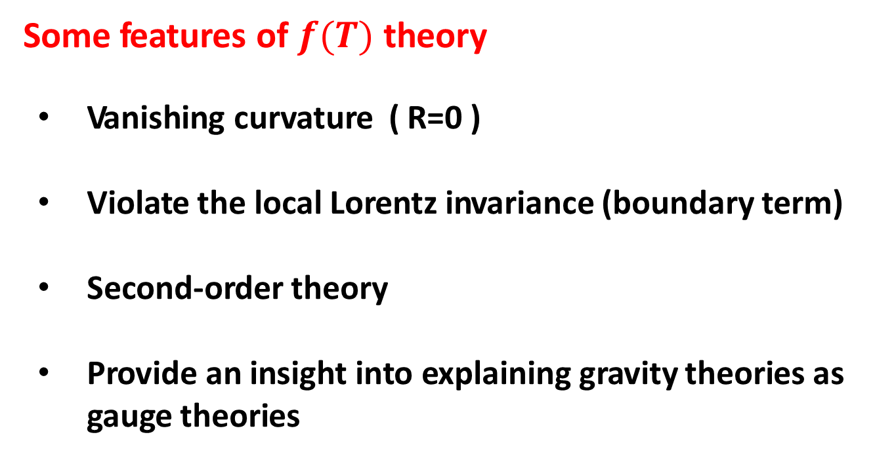
1. Introduction
Some features of $f(T)$ theory
Vanishing curvature ( R=0 )
Violate the local Lorentz invariance (boundary term)
Second-order theory
Provide an insight into explaining gravity theories as gauge theories

Slide 10
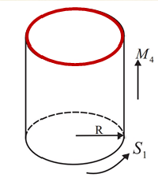
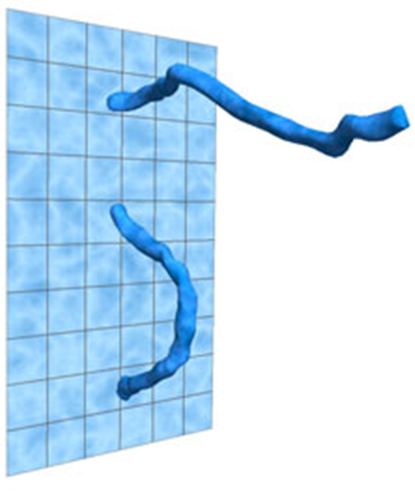
1. Introduction
Extra dimensions and braneworlds
1920s, Kaluza-Klein Theory
1970s-90s, Stirng/M theory
R: Planck length

Slide 11
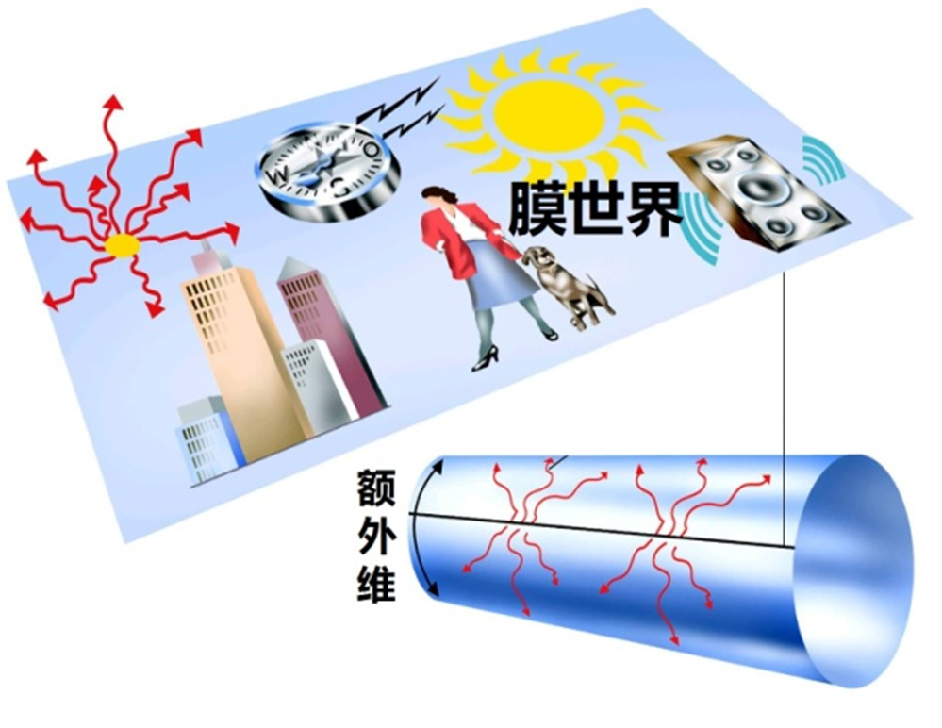
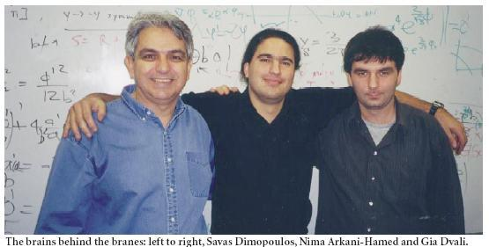
1. Introduction
Extra dimensions and braneworlds
1998, Large Extra Dimensions (ADD Braneworld Scenario)
Gauge hierarchy problem (M_{EW} << M_{Pl} ) [PRD59 (1999) 086004]
Arkani-Hamed, Dimopoulos, and Dvali
R: sub-millimeters
N. Arkani-Hamed, S. Dimopoulos and G. R. Dvali, PRD59 (1999) 086004.

Slide 12
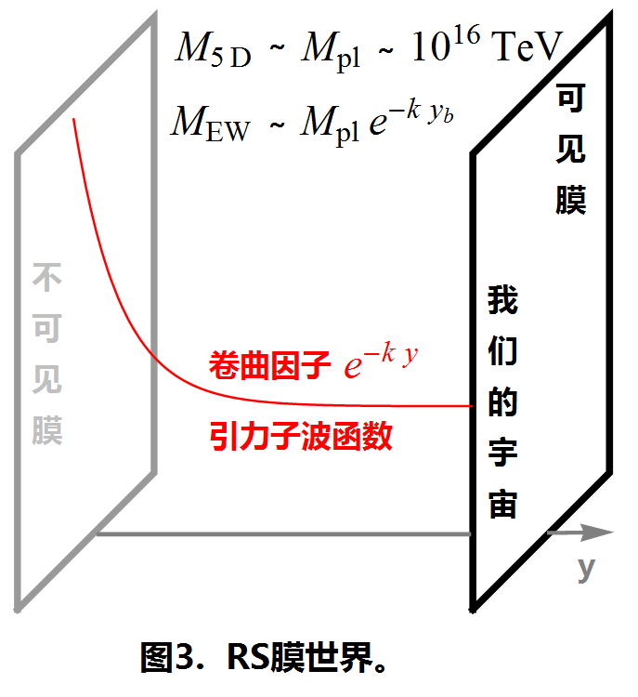


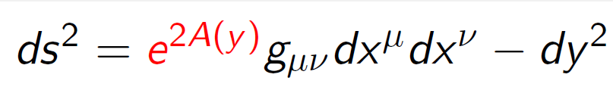
1. Introduction
Extra dimensions and braneworlds
1999, Warped Extra Dimension (RS thin Brane Scenario )
Gauge hierarchy problem (M_{EW} << M_{Pl} ) [PRL 83 (1999) 3370]
Randall and Sundrum (RS)
Branes with finite ED
Notes:
4D space-time is seen as a brane (hypersurface) embedded in higher-dimensional space-time
Matter and gauge fields are confined on the brane, only
the gravity can propagate in the bulk

Slide 13
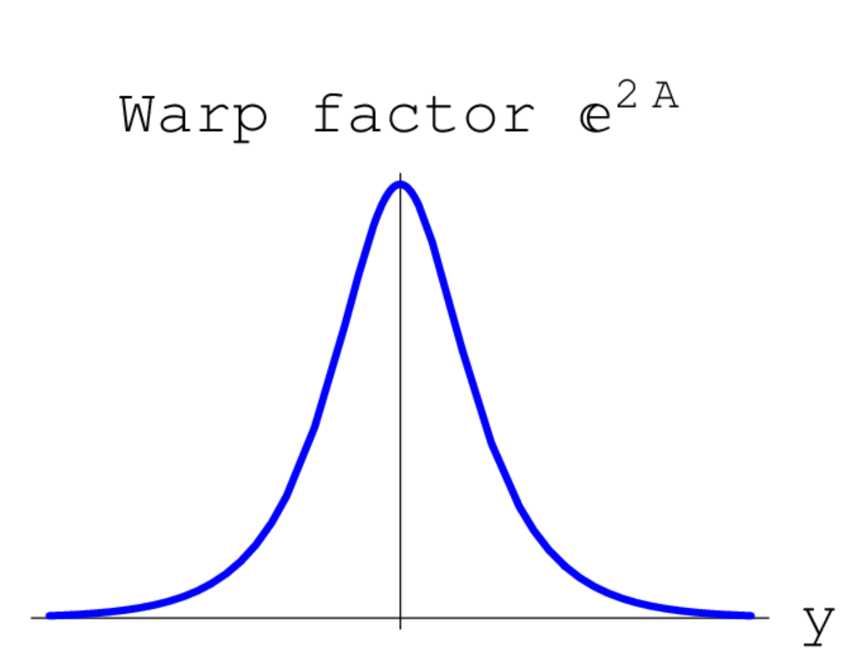
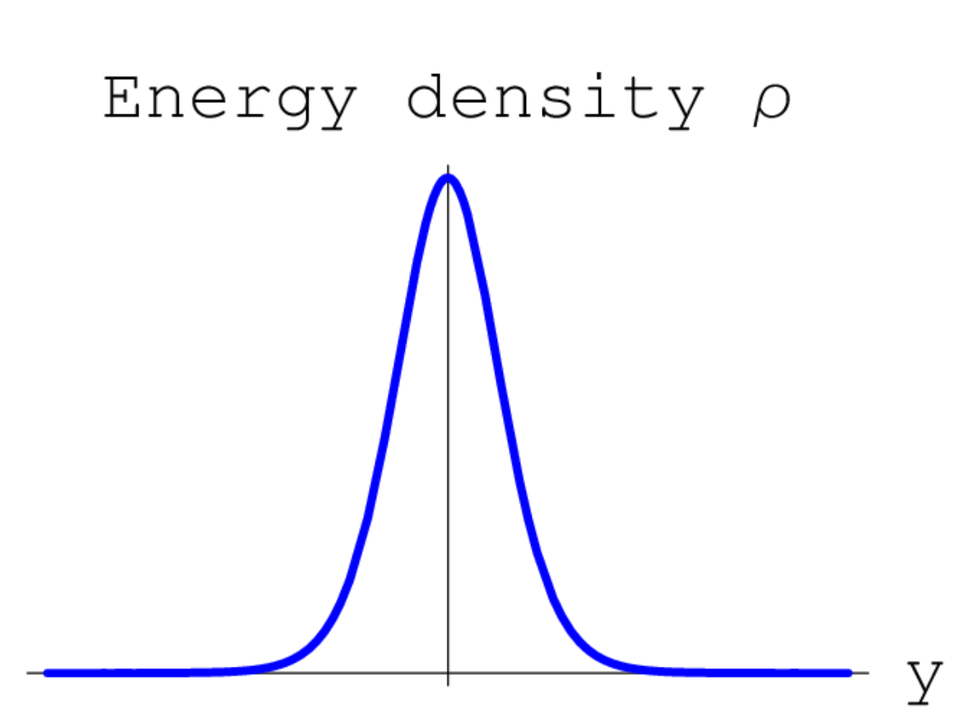
1. Introduction
Extra dimensions and braneworlds
1999, Thick Braneworld Scenario in GR
DeWolfe, Freedman, Gubser, and Karch
Brane with Infinite ED

Slide 14
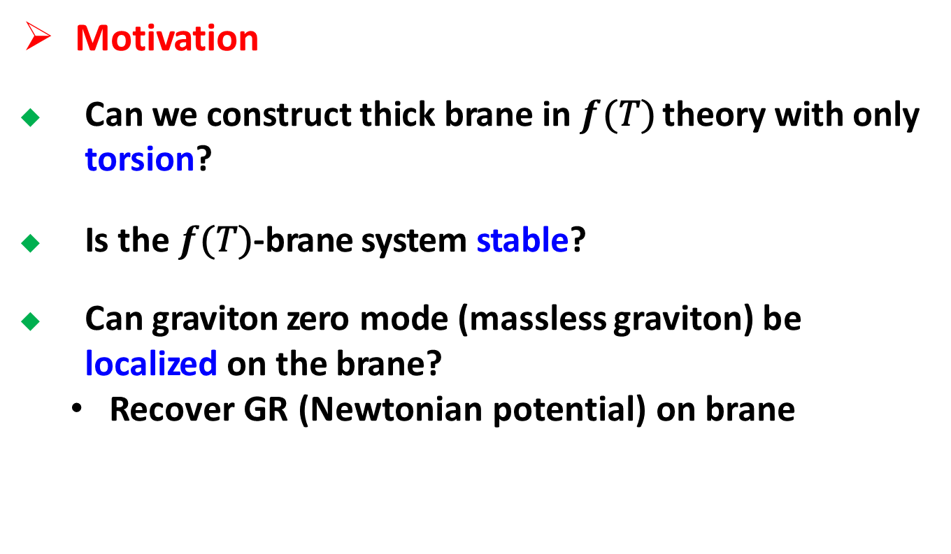
1. Introduction
Motivation
Can we construct thick brane in $f$(𝑇) theory with only torsion?
Is the $f$(𝑇)-brane system stable?
Can graviton zero mode (massless graviton) be localized on the brane?
Recover GR (Newtonian potential) on brane

Slide 15
Contents
1. Introduction
2. f(T) brane solutions
3. Stability and localization
4. Summary

Slide 16
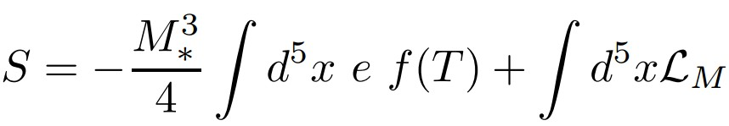

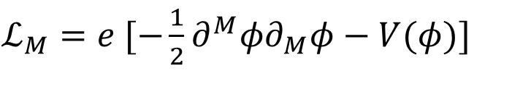
2. f(T) brane solutions
Model 1—canonical scalar field [2]
The action of f(T) theory is
where we first consider a canonical scalar field
$ℒ_{M}=e [−\frac{1}{2}∂^{M}φ∂_{M}φ−V(φ)$]
The metric is assumed as
[2] J. Yang, Y. L. Li, Y. Zhong, and Y. Li, PRD 85 (2012) 084033.

Slide 17
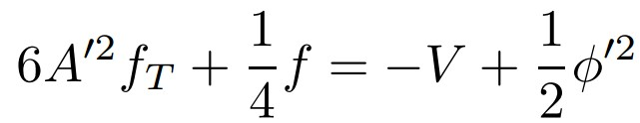
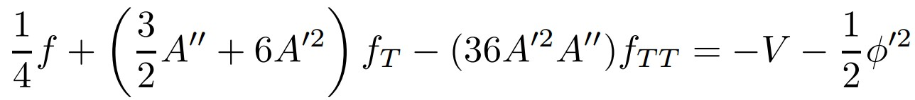
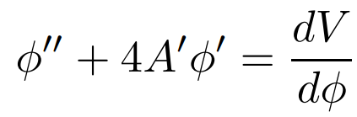
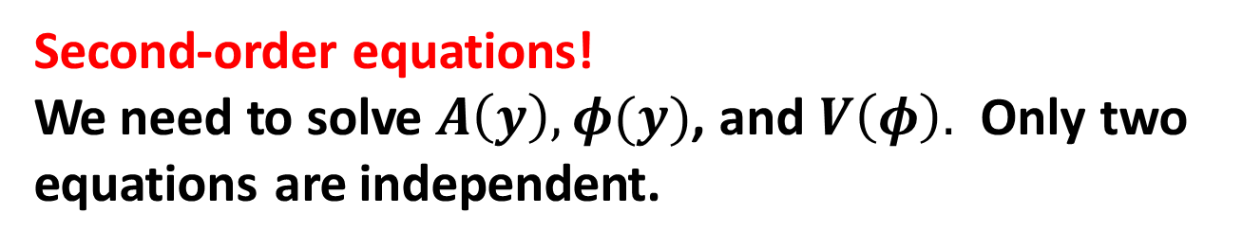
2. f(T) brane solutions
Dynamical equations
Second-order equations!
We need to solve $A\left(y\right), φ(y)$, and $V\left(φ\right).$ Only two equations are independent.

Slide 18

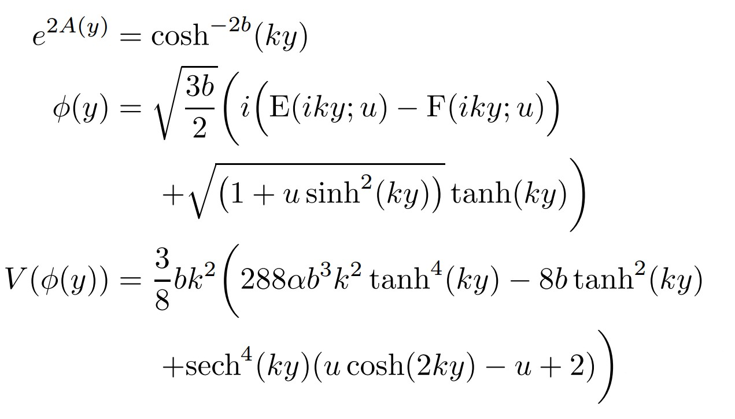
First analytical solution [2]
2. f(T) brane solutions
y
[2] J. Yang, Y. L. Li, Y. Zhong, and Y. Li, PRD 85 (2012) 084033.

Slide 19
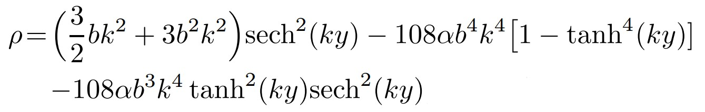
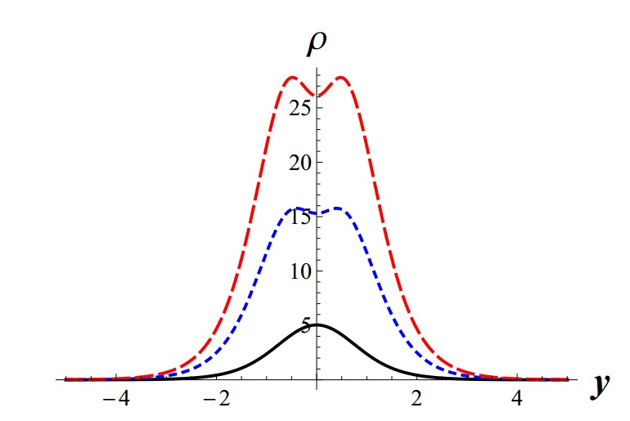
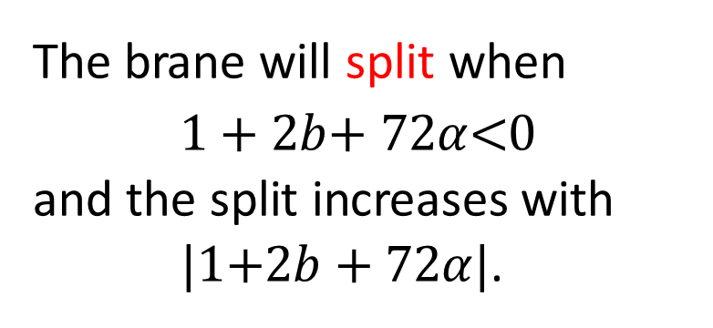
2. f(T) brane solutions
The energy density for
The brane will split when
1 + 2$b$+ 72$α$<0
and the split increases with
|1+2$b$ + 72$α$|.
b = 1,
𝛼 | = | −0.005 (the black solid lines),
𝛼 𝛼 | = = | −0.1 (the blue dotted lines), −0.2 (the red dotted lines).

Slide 20

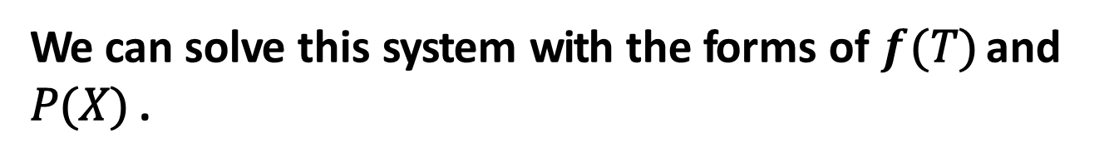
2. f(T) brane solutions
Model 2—noncanonical scalar field (K-field) [3]
Inflation
Lagrangian of the background matter
where X is the kinetic energy
Dark energy
We can solve this system with the forms of $f$(𝑇) and 𝑃(𝑋) .
[3] J. Wang, W.-D. Guo, Z.-C. Lin, and Y.-X. Liu, PRD 98 (2018) 084046.

Slide 21


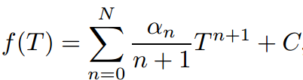

2. f(T) brane solutions
We have solved this system with the given warp factor
y
for two forms of $f(T)$ [3]
Exponential
Polynomial
[3] J. Wang, W.-D. Guo, Z.-C. Lin, and Y.-X. Liu, PRD 98 (2018) 084046.
Notes:
Exponential ɛkspəˈnɛnʃəl] polynomial [ˌpɒlɪ'noʊmɪrl]

Slide 22

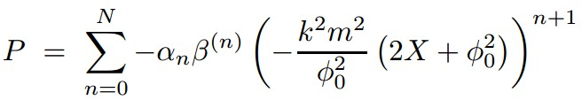
2. f(T) brane solutions
Here, we show the solution for [3]
f_{T} = df/dT
[3] J. Wang, W.-D. Guo, Z.-C. Lin, and Y.-X. Liu, PRD 98 (2018) 084046.

Slide 23

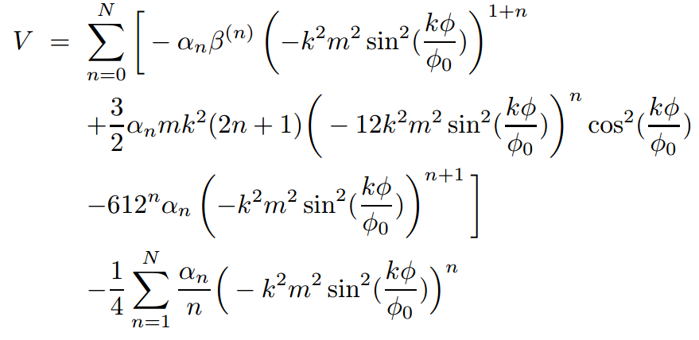

The solution is given by [3]
2. f(T) brane solutions
This will cause split of the brane.
[3] J. Wang, W.-D. Guo, Z.-C. Lin, and Y.-X. Liu, PRD 98 (2018) 084046.

Slide 24
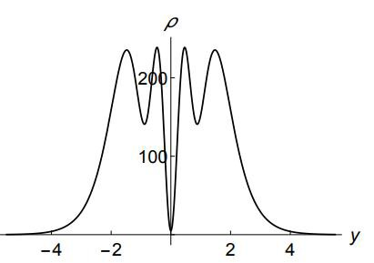
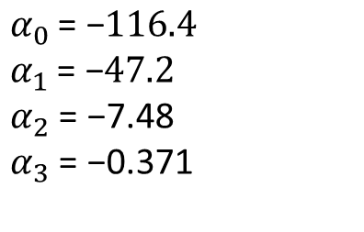
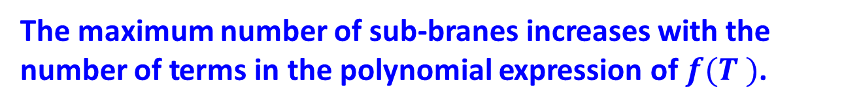
2. f(T) brane solutions
Energy density ( $f_{T}= α_{0}+α_{1}T+α_{2}T^{2}+α_{3}T^{3}$ )
$$α_{0 }\text{=} \text{−}116.4$$
$$α_{1 }\text{=} \text{−}47.2$$
$α_{2}$ = −7.48
$α_{3}$ = −0.371
The maximum number of sub-branes increases with the number of terms in the polynomial expression of $f(T )$.

Slide 25
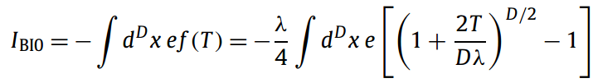


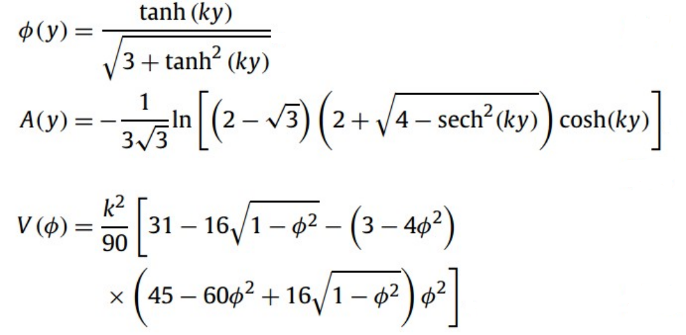
2. f(T) brane solutions
Model 3—Reduced Born-Infeld-f(T) brane [4]
Solution:
[4] K. Yang, W.-D. Guo, Z.-C. Lin, and Y.-X. Liu, PLB 782 (2018) 170.

Slide 26
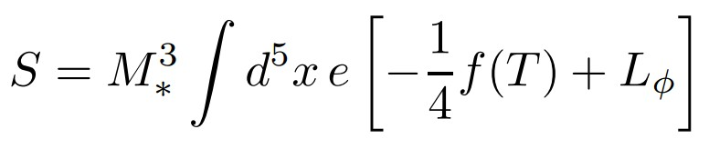
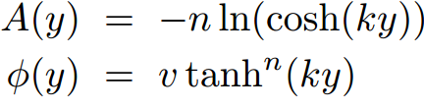

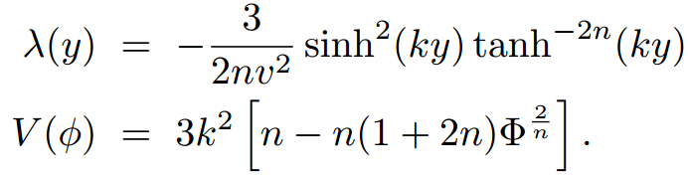
2. f(T) brane solutions
Model 4—Mimetic f(T) brane [5]
Solution:
[5] W.-D. Guo, Y. Zhong, K. Yang, T.-T. Sui, and Y.-X. Liu, arXiv:1805.05650

Slide 27
Contents
1. Introduction
2. f(T) brane solutions
3. Stability and localization
4. Summary

Slide 28
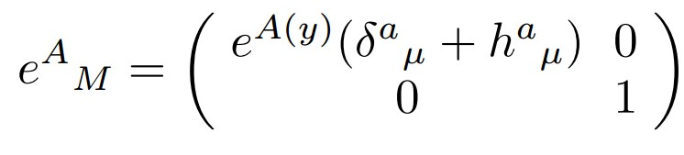
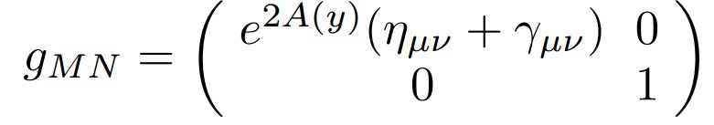

3. Stability and localization
Tensor perturbation [6]
Perturbed vielbein [6]
The corresponding perturbed metric
[6] W.-D. Guo, Q.-M. Fu, Y.-P. Zhang, and Y.-X. Liu, PRD 93 (2016) 044002.

Slide 29

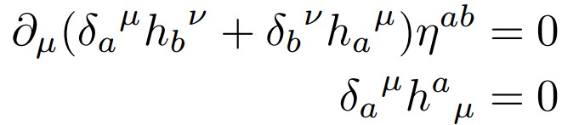
3. Stability and localization
Transverse-traceless (TT) gauge

Slide 30
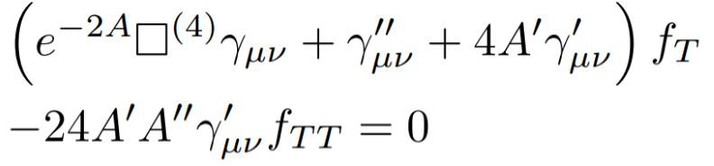

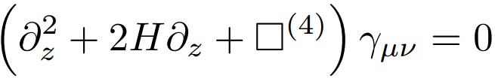
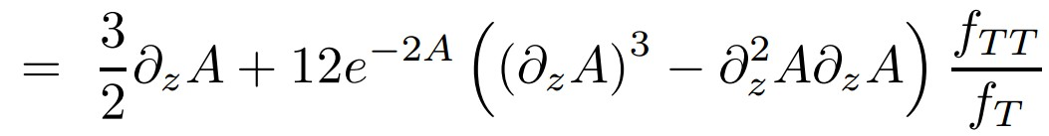

3. Stability and localization
Main equation
Coordinate transformation
The main equation is transformed to
where

Slide 31
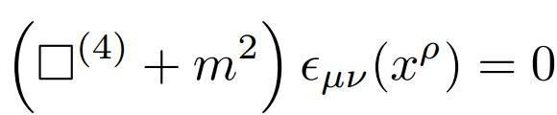



3. Stability and localization
KK decomposition
KG-like equation
Schr$\ddot{o}$dinger-like equation

Slide 32

3. Stability and localization
𝑚² ≥ 0
stable! [6]
[6] W.-D. Guo, Q.-M. Fu, Y.-P. Zhang, and Y.-X. Liu, PRD 93 (2016) 044002.

Slide 33
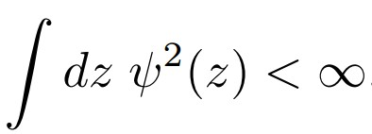

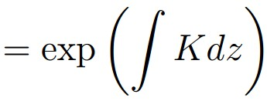

3. Stability and localization
Localization
Normalization condition
Finite 4D action
Solution of the graviton zero mode

Slide 34
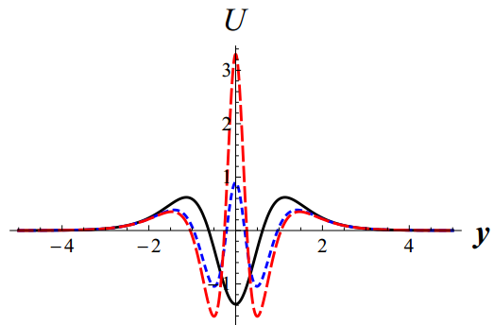
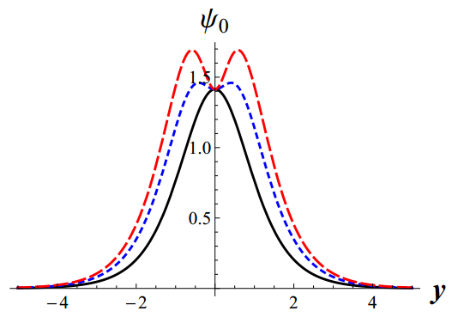


3. Stability and localization
Localization
canonical scalar field
$f(T)=T+αT^{2}$
localized zero
mode
Split
Finite 4D
action
$$V(r ) ∝\frac{1}{r}$$
[6] W.-D. Guo, Q.-M. Fu, Y.-P. Zhang, and Y.-X. Liu, PRD 93 (2016) 044002.
Notes:
FIG. 2 : Plots of the energy density, effective potential, and zero mode for the brane solution of $f(T ) = T +αT^{2}$ The parameters are set to b = 1, α = -0.005 (the black solid lines), α = -0.1 (the blue dotted lines), and α = -0.2 (the red dotted lines).

Slide 35





3. Stability and localization
Localization
noncanonical scalar field
localized zero
mode
$$V(r ) ∝\frac{1}{r}$$
Split
[3] J. Wang, W.-D. Guo, Z.-C. Lin, and Y.-X. Liu, PRD 98 (2018) 084046.

Slide 36

4. Summary
We constructed some thick branes in $f$(𝑇) gravity with some scalar fields.
These branes have a split.
The solutions are stable.
The graviton zero mode can be localized on the brane, and so Newtonian potential (1/r) can be recovered.
Thanks!

